Slide 1
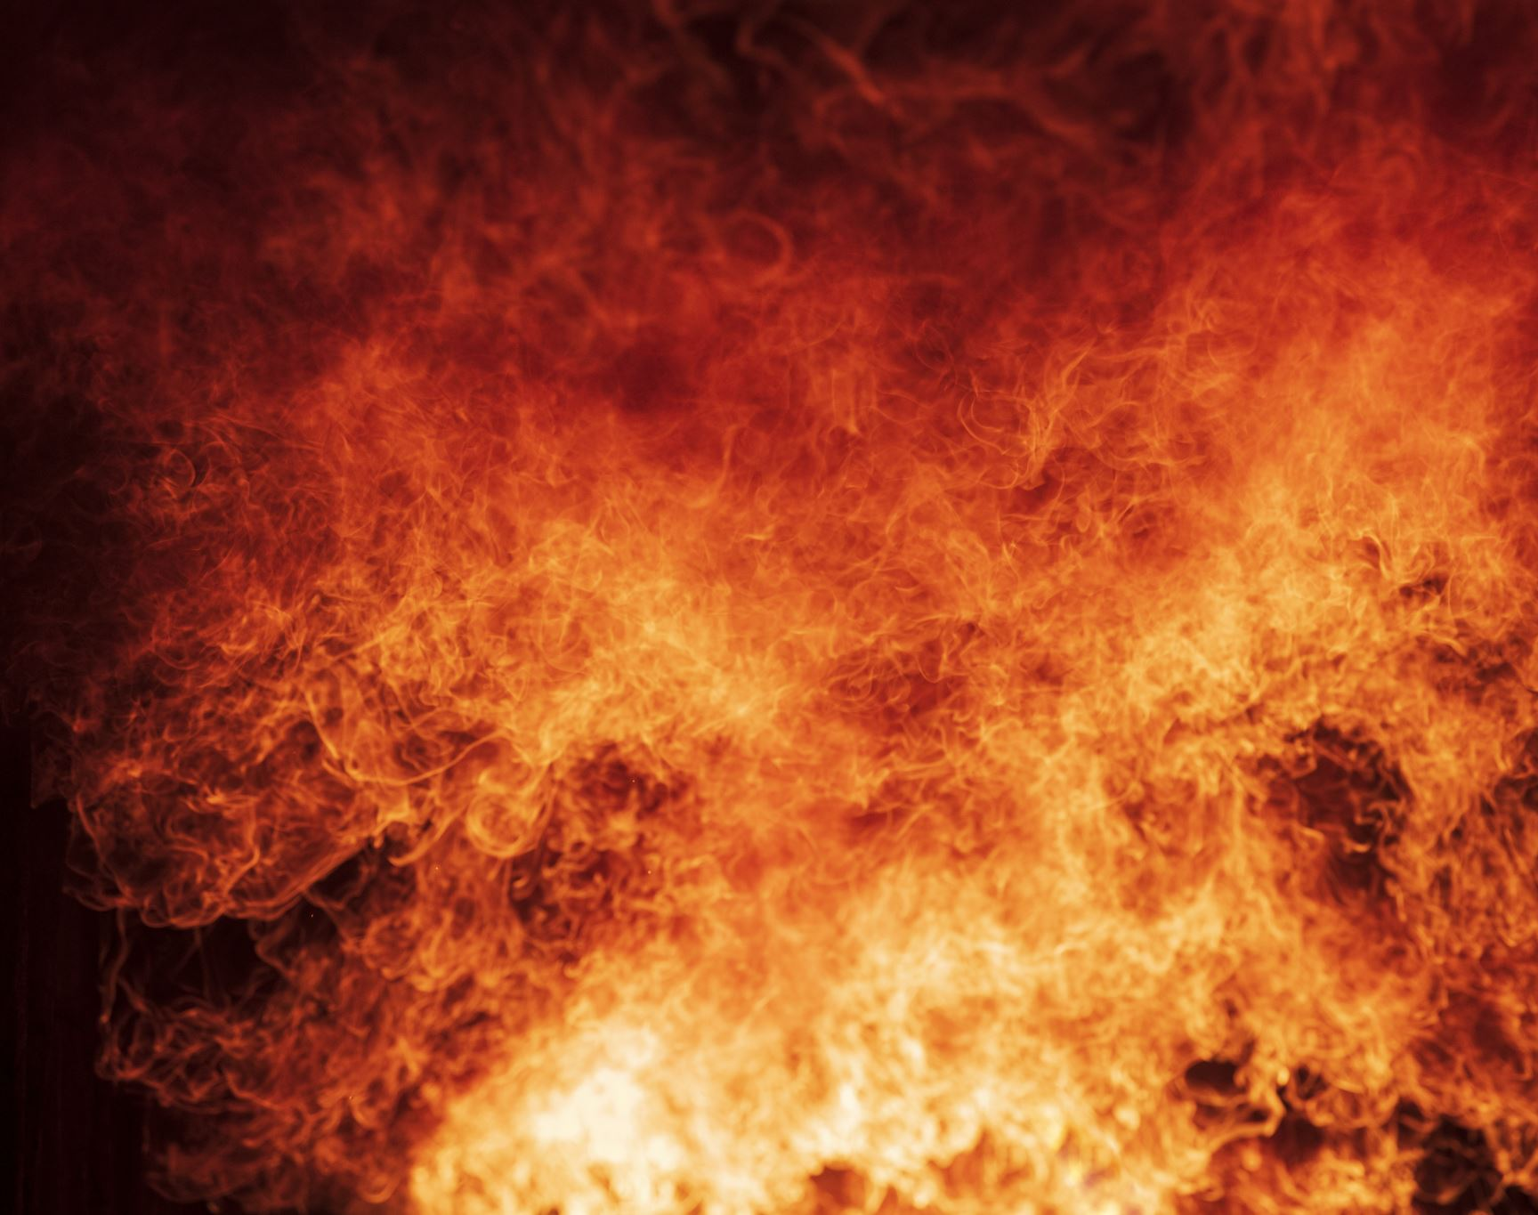
East Clinton Fire District
New Facility

Slide 2
Overview
Fire District Finances
Fire Department Response
Why do we need new Facility?
Plans, Cost & Location

Slide 3
Tax Levy & Reserve Funds

Slide 4
LOSAP

Slide 5
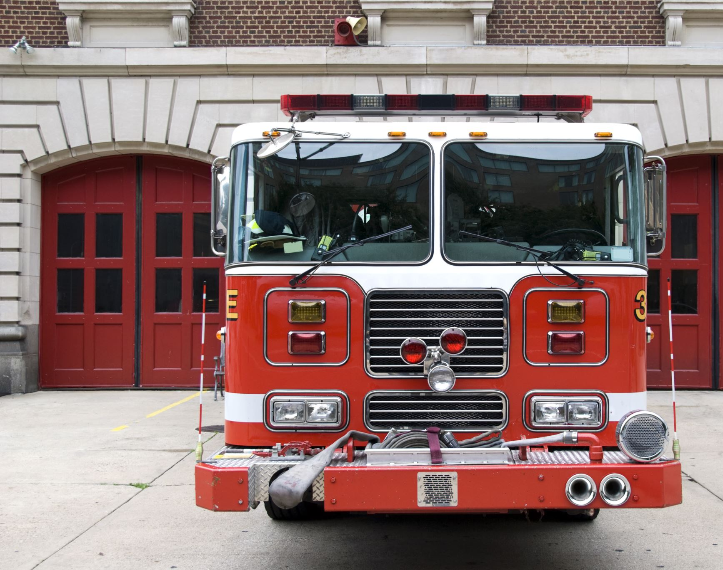
Indebtedness
$0.00
Loan for 38-12 Fire Engine paid off

Slide 6
Vehicles purchased
2010 Ford Ambulance from Sharon, CT FD
2019 Ford Brush Truck with Skid Unit
2022 Ford Light Rescue with Pump
2017 Ford Explorer Chief’s Vehicle
2017 Ford Explorer Rescue Captain’s Vehicle

Slide 7
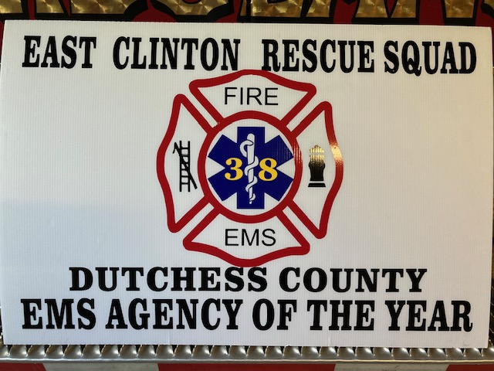
Rescue Squad

Slide 8
Rescue Response
East Clinton Rescue Squad supplies BLS Service
We do not Bill
When is ALS Required?
NDP or Empress

Slide 9
East Clinton Responses EMS & Fire

Slide 10
Response Rate January 1, 2022 thru March 31, 2025 EMS & Fire
98.8%
100% Volunteer

Slide 11
Volunteer vs. Not

Slide 14
Facility
Built in 1957 over the top of the old RR Station
Not Handicapped accessible
Lack of Storage
Lack of appropriate Decontamination capabilities
Lack of Turn-out gear Cleaning capabilities
Lack of Meeting space for training
Too small for current Vehicles
Vehicles Double Stacked in Bays

Slide 15
A Changing Landscape
Rubber Boots, Leather Helmets- Late 1970’s
Turn out Gear – Protective Envelope with Nomex, Vapor Barrier, insulation
Scott Packs – 1960
Jaws of Life - 1987
Thermal Imaging Cameras
Radios, pagers
Vehicle Size
Amount of Training- OSHA/PESH
Safety Training
Equipment Standards

Slide 16
Fire Engines

Slide 17
Fire Engines 1940 American LaFrance 500 GPM Pump 500 Gallon Tank

Slide 18
Fire Engines 1250 GPM Pump 1500 Gallon Tank

Slide 19
Fire Engines

Slide 20
Fire Engines

Slide 21
Fire Engines 1250 GPM Pump 2500 Gallon Tank Will Mutual Aid vehicles fit?

Slide 22
Urban vs. Rural Water Sources
No Hydrants
Reliance on Ponds, Creeks, Dry Hydrants
Mutual Aid
We need to bring our water to the scene

Slide 23
ISO Rating
Now 8B- Was 10
Training
Responses
Personnel Qualifications
Water to the scene- 200 GPM for 20 minutes = 4000 gallons
15.2% Insurance Savings – NYCM
House valued at $339k saved $137.00 annually

Slide 24
First Line of Response
38-12 First Out Attack Engine – 1500 gallons
38-38 Tanker/Pumper – 2500 gallons
Total 4000 gallons

Slide 25
Elevations

Slide 26
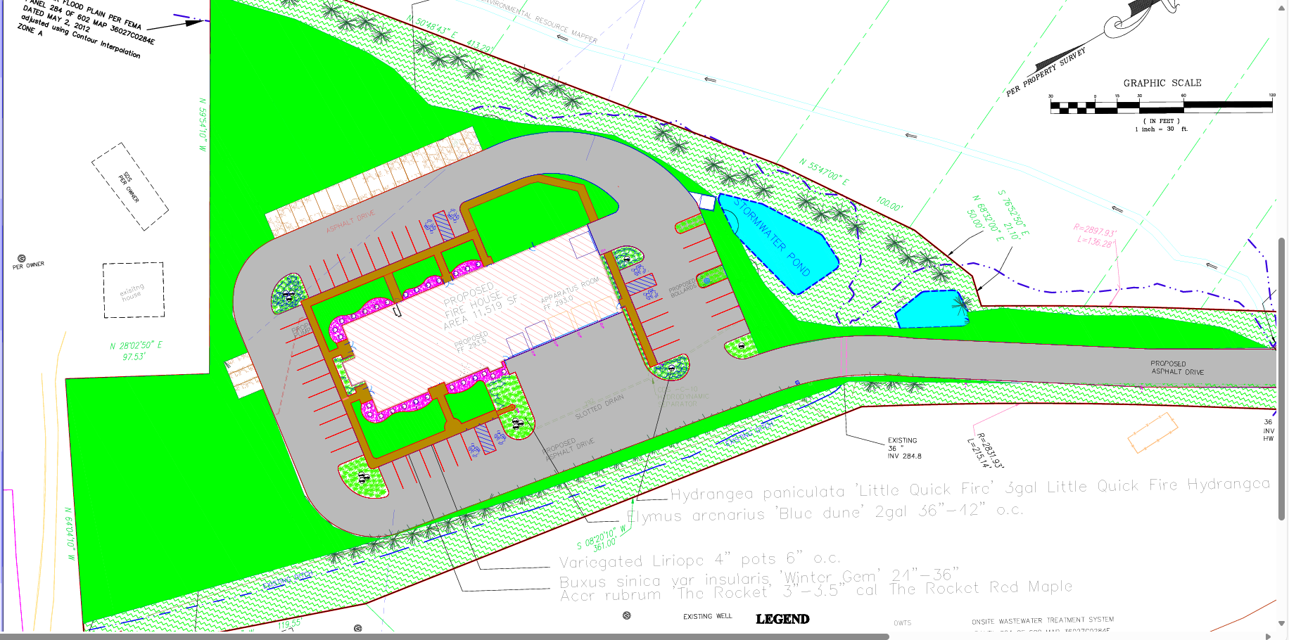
Site Plan

Slide 27
Call Demographics
Map
January 2022 – August 2024 Call statistics
Total In-District is 601 calls vs 751 Total calls
Difference is Mutual Aid
401 calls less than three miles from station = 67%
159 three to five miles from station = 26%
32 greater than five miles from station = 5%
EMS calls are 60% of total call volume – See staffing locations
West Clinton dispatched on all potential fires for northern portion
Road layouts hinder central station location – TSP access is critical for MVAs and to respond to the entire district

Slide 28
How to Pay For The Project and What Will it cost?
The total cost of the project is $6.0 million.
The Fire District has diligently been setting aside reserves.
$1.5 million in building reserves will be used to offset financing.
The Fire District will issue $4.5 million of tax-exempt bonds to fund the proposed capital improvement.
The capital improvement will be financed over 30 years, the estimated useful life of the building.
The interest rate on the bonds is estimated at 5.00%, but will be determined at the time of sale.
The annual debt service is estimated at $293,000.
Estimated household cost of $4.48 per month per $100,000 of assessed value.

Slide 29
Cost Perspective
Property assessed at $339k saved $137 annually on insurance costs
Same property will pay $182 annually for debt service
Annual debt service of $293k is less than any neighboring district is paying for EMS contract

Slide 30
Cost Perspective
2025 Annual Budget was raised $53,950
Included was debt service of $150K
Actual budget increase could be as low as $143K
Budget effect of debt service is $2.19 per month per $100K
For $339K house that equates to $89 annually, less than insurance offset

Slide 31
REFERENDUM VOTE
JUNE 3, 2025
VALLEY COMMUNITY CHURCH
2260 SALT POINT TURNPIKE
CLINTON CORNERS
4:00 PM – 9:00 PM

